Slide 1


Slide 2
What Is Aperio?
Water Quality Sensor
Turbidity, salinity, contaminants, etc.
Purity Score
Alerts
Notes:
Aperio is a water quality sensor that measures Turbidity, Salinity, and contaminants. Aperio collects data and passes through a algorithm to generate a purity score on the read-out, a grade on how clean your water is. This purity score is also
Accessible online on the website and our smartphone application. Finally, Aperio alerts you if your purity score falls below a threshold, through your choice of a readout, SMS, app, and/or email

Slide 3
Design Goals
Cost Effective Production
Consumer Marketability
Device Connectivity
Notes:
Our Design Goals include cost effective production, consumer marketability, and device connectivity

Slide 4
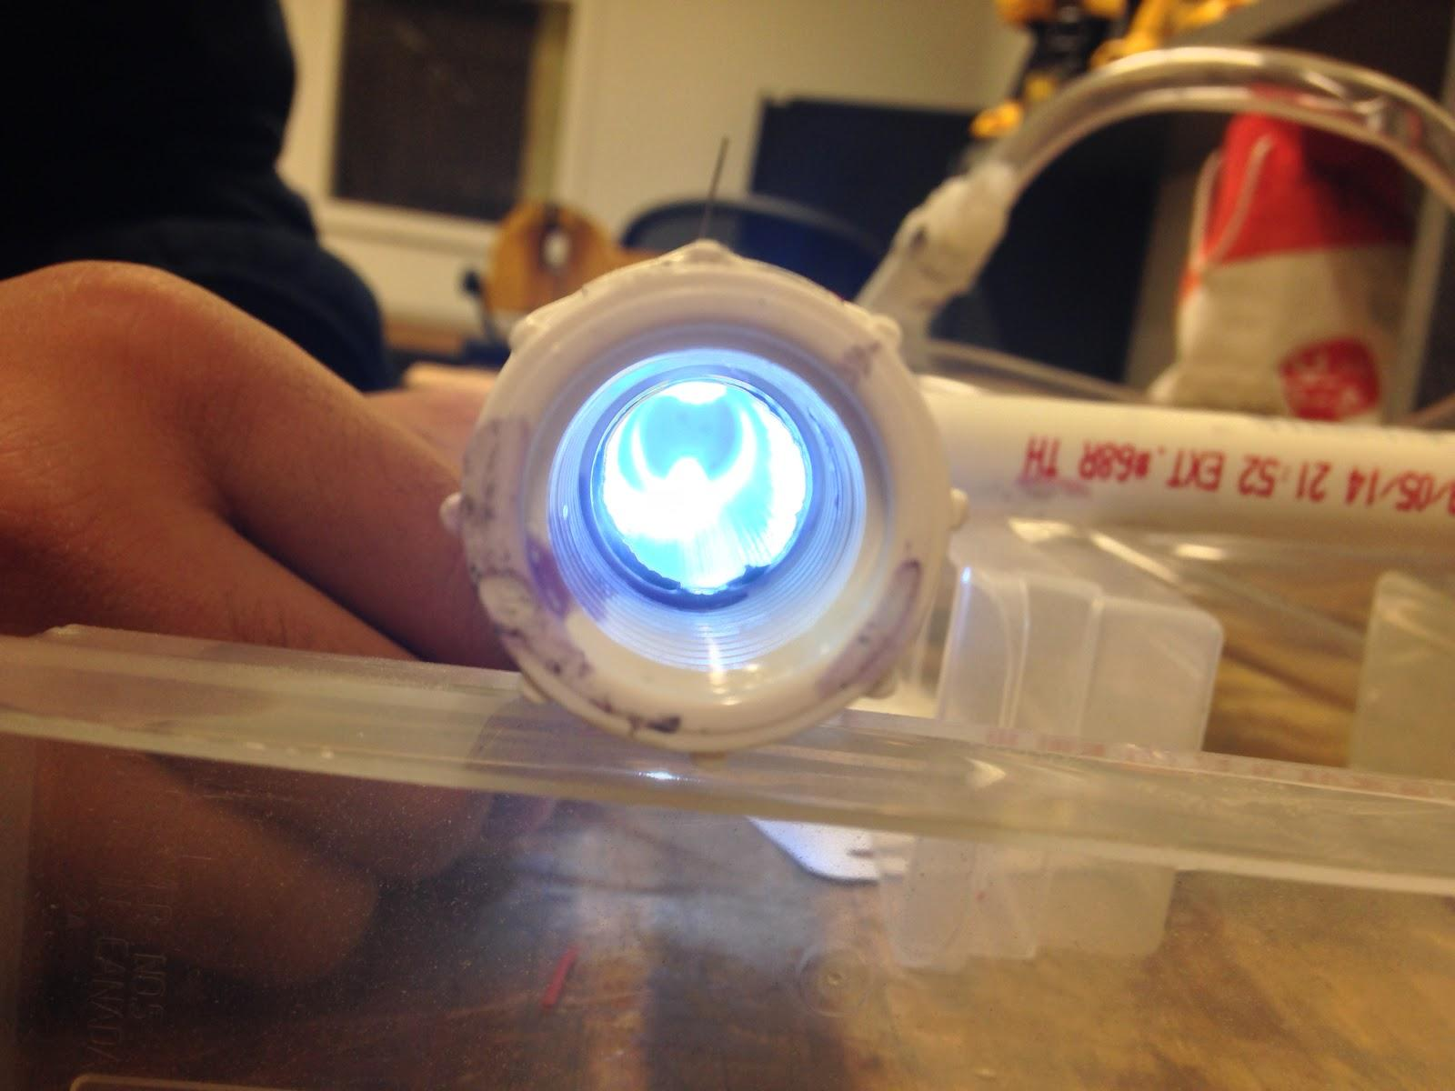
Current Prototype

Slide 5
Target Audience
Young Adults
Parents
Environmental awareness
Kickstarter
Technology
-Social Networks
Health Concerns
Home appliances
Notes:
Our Target Audience include Young Adults and Parents. We are targeting Young Adults due to the fact that we are of the age of a young adults, they are all of our peers meaning they make up most of our network. Younger People usually
Care more about environmental awareness and cimate change meaning Aperio’s effect of increasing water quality due to notifying terrible water quality will resonate with them. Kickstarter is [rimaarily composed of Young Adults, so for funding
We will need to obain money from young adults. Finally, young adults are more prevalent on the internet, making it easier to connect with them. We are targeting parents as parents have health concerns for their young children, meaning that a water quality sensor will protect their children. Also, due to the kids, parents have a mindset that causes them to worry a lot more, making the sensor great for them. Also Aperio will be included in the home appliances retail section, and mostly parents shop there

Slide 6
Acquiring Data
Website
Social networks
Questionnaire
Gauging interest
Notes:
To acquire data we started up social networking pages, such as facebook and google plus, and used these pages to attract friends and attempt to get them to disseminate it to their friends. We linked our website to all of our social networking posts to obtain an email list for our questionnaire. This questionnaire was used to gauge interest in our product

Slide 7
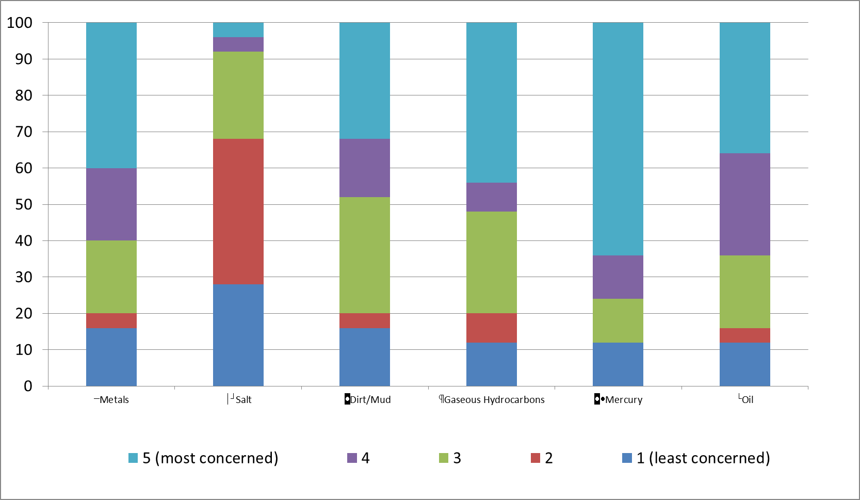
Responses
Notes:
These Responses detail how worried people are on each contaminant. As you can see, these contaminants each have different levels of concern.

Slide 8
Beta Analysis
Add-on solution instead of full faucet
Confidence in city water
Cheap
Notes:
Many of the responses desired that we were to only sell an add-on rather than a full faucet, as it seems many are content with their existing faucets. Also, many expressed distaste with the product as they wondered why buy Aperio if you can
Just buy a filter. ‘A filter does not give information, and information can be used to take preventative steps. One response that seems to be irreversible is that many people have confidence in their water utilities, requiring no need for Aperio. Lastly, if the product is relatively cheap it would be bought by many, as without a track record, the product is not one that is enviable.

Slide 9
Application of Analysis
Aperio Micro add-on
Sensor Priority List
Top Water Utilities
Cost-efficient
Continue the project
Notes:
Using the data given, we have decided to make these changes to our design and marketing plan. As the add-on appears to be more popular than the faucet, the Aperio micro might end up being our flagship product. Also, adter evaluating the responses on how worried you are for the contaminant, we can simply prioritize which sensors to include in the product based upon which contaminant people were most worried for. As most people have confidence in their water utilities, to get these people to buy our product, we will need to focus on having Aperio outperform these water utilities. Also, the product must be cost-efficient to be as cheap as possible when it goes live. Finally, as people have truly indicated that they are worried about their water through the survey, this project is one that we wish to continue!

Slide 10
Visit us at aperiofaucet.net github.com/mdiamond14/Aperio/ kickstarter.com/projects/545246334/844326656?token=9b80a16d

